Slide 1
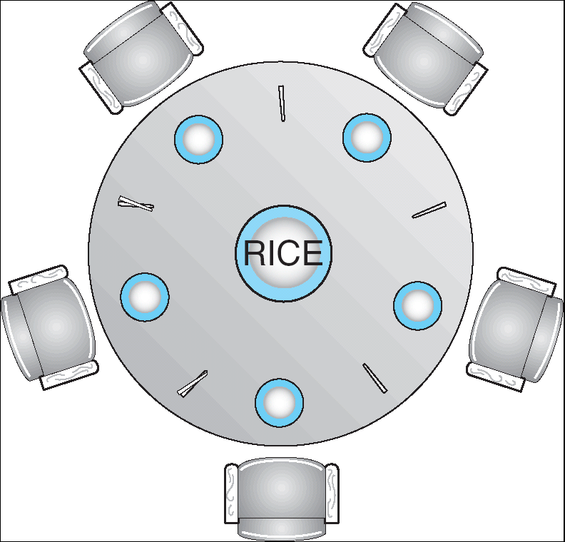
Dining-Philosophers Problem
Shared data
  Bowl of rice (data set)
  Semaphore chopstick [5] initialized to 1

Slide 2
Dining-Philosophers Problem (Cont.)
The structure of Philosopher i:
    Do {
    wait ( chopstick[i] );
    wait ( chopStick[ (i + 1) % 5] );
    // eat
    signal ( chopstick[i] );
    signal (chopstick[ (i + 1) % 5] );
    // think
    } while (true) ;

Slide 3
Dining-Philosophers Problem (Cont.)
The structure of Philosopher i:
    Do {
    wait ( chopstick[i] );
    wait ( chopStick[ (i + 1) % 5] );
    // eat
    signal ( chopstick[i] );
    signal (chopstick[ (i + 1) % 5] );
    // think
    } while (true) ;
Deadlock!- no progress
Each picks
Left fork at same time
And all wait forever

Slide 4
Conductor solution
do
{wait(mutex)
wait(i)
wait((i+1)%5)
signal(mutex)
//eat
signal(i)
signal((i+1)%5)
think
}while(true)

Slide 5
Conductor solution
do
{wait(mutex)
wait(i)
wait((i+1)%5)
signal(mutex)
//eat
signal(i)
signal((i+1)%5)
think
}while(true)
Lets say P1 got both his forks
and is eating.
P2 reaches step 3 after getting
one fork and is waiting for the other
which is being used by P1.
➔P2 is still inside the mutex lock
which does not permit P4 to request forks
though both his forks are idle.
Concurrent execution not
Possible due to mutex lock

Slide 6
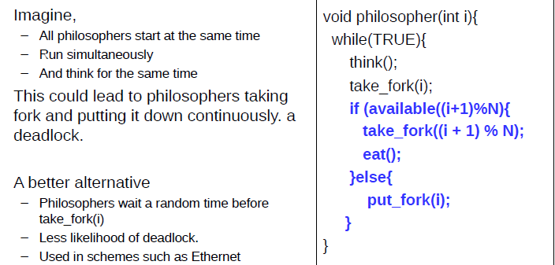
Move with precaution

Slide 7
Move with precaution
All pick fork together to realise other fork is not
available. So all put back fork together. This goees on.

Slide 8
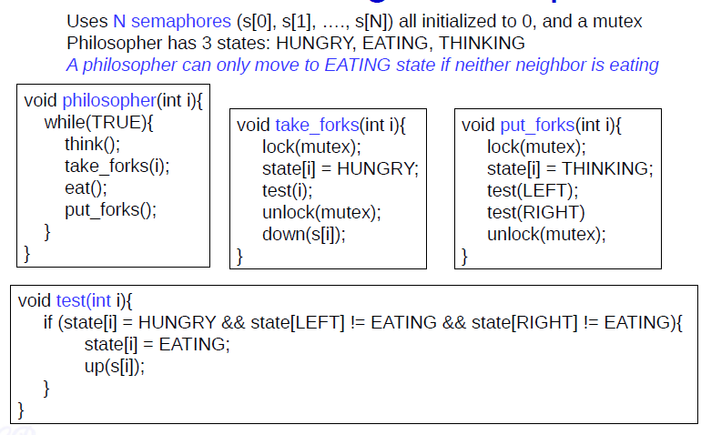
Tannenbaum solution

Slide 9
Up(fork) is like signal(fork)
Down(fork) is like wait(fork)
wait(fork){ fork --; while (fork <0);}

Slide 10
Chandy Misra solution
For every pair of philosophers contending for a resource, create a fork and give it to the philosopher with the lower ID (n for agent P_{n}). Each fork can either be dirty or clean. Initially, all forks are dirty.
When a philosopher wants to use a set of resources (i.e. eat), he must obtain the forks from his contending neighbors. For all such forks he does not have, he sends a request message.
When a philosopher with a fork receives a request message, he keeps the fork if it is clean, but gives it up when it is dirty. If he sends the fork over, he cleans the fork before doing so.
After a philosopher is done eating, all his forks become dirty. If another philosopher had previously requested one of the forks, he cleans the fork and sends it.
https://ycpcs.github.io/cs420-fall2017/lectures/lecture12_classic_synchronization_problems.pdf

Slide 11
Rules
Initially forks dirty
After eating forks dirty
If someone had requested for your fork when you were eating, then clean and give it after you finish eating
If you have both forks start eating
I need to give a fork on request only if its dirty. I clean it and give it. If the fork is clean it means I have requested and got it and have not eaten yet. In such a case I do not give it up.
Initially the one with lower id gets preference. So if P1 requests forks initially, then he will get both forks. Deadlock situation wont arise.
Starvation wont arise since a philosopher who has eaten has to wait if his neighbors have requested for fork.

